Slide 1
Office Trashbot
Faculty of Information Technology
IN 1900 ICT Project
Final Presentation
Group No: 18

Slide 2

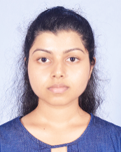
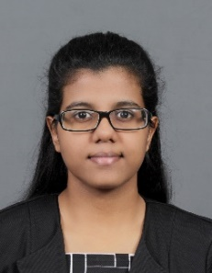


Group Members
 | Name | Reg. No: | Photo
Group Leader | Hathnagoda H.W.E.M.J.N | 204071C
Member 1 | Jayasekara J.P.I.A | 204084T
Member 2 | Madhushika B.A.E | 204118E
Member 3 | Rambukkamage R.D.S.T | 204172L
Member 4 | Samararathna B.S. | 204184B

Slide 3
Problem in brief
Without proper monitoring, waste can stagnate in our trash cans.
A possible solution is to take out the trash frequently, but that may also be wasteful if the trash can is mostly empty.
Likewise, different amounts of waste are generated day by day, so predicting exactly when to take out the trash becomes more difficult.
This becomes even more difficult considering the number of trash cans in a workplace.

Slide 4
Aim & Objectives
Aim:
Design and develop a robot to improve the trash management process in IT companies.
Objectives:
To collect trash automatically in workplaces by going predefined route
To sort trash by separating polythene and papers
To collect trash inside office rooms by sending a message to the person inside the room.
To notify refuse collector by measuring the trash level

Slide 5
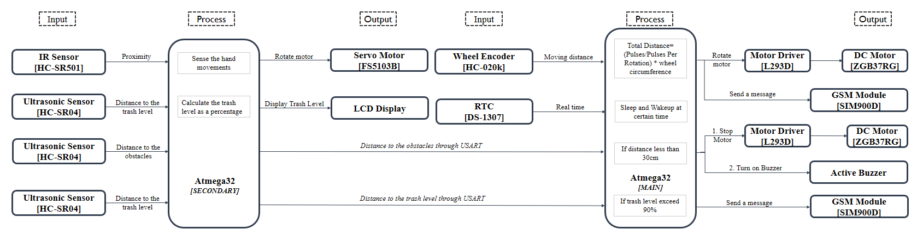
Proposed Solution
IT_Group18_InputOutputDiagram.pdf

Slide 6
Circuit Diagram

Slide 7
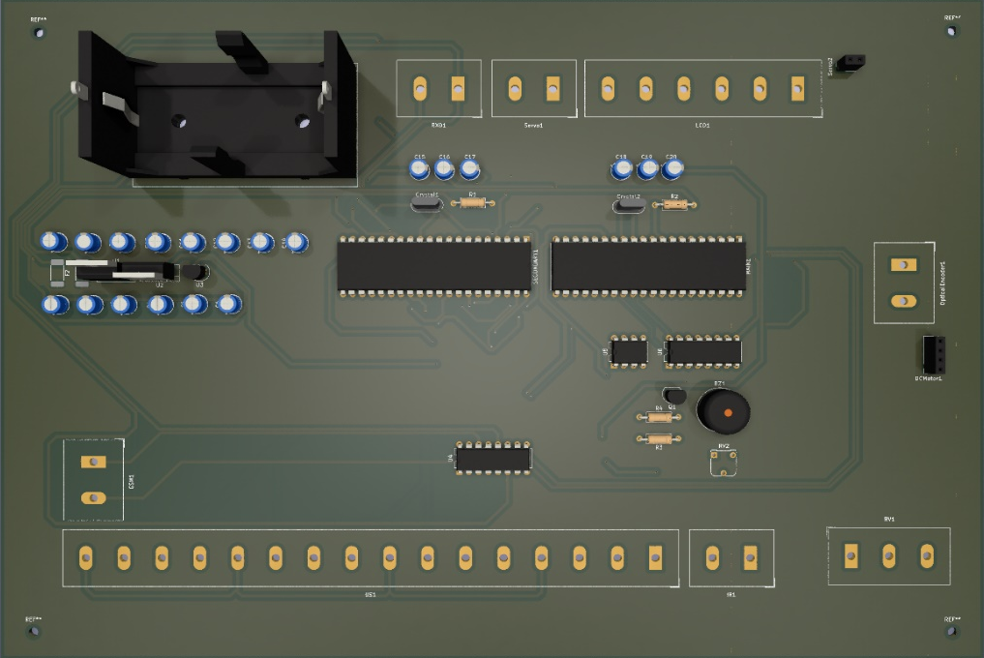
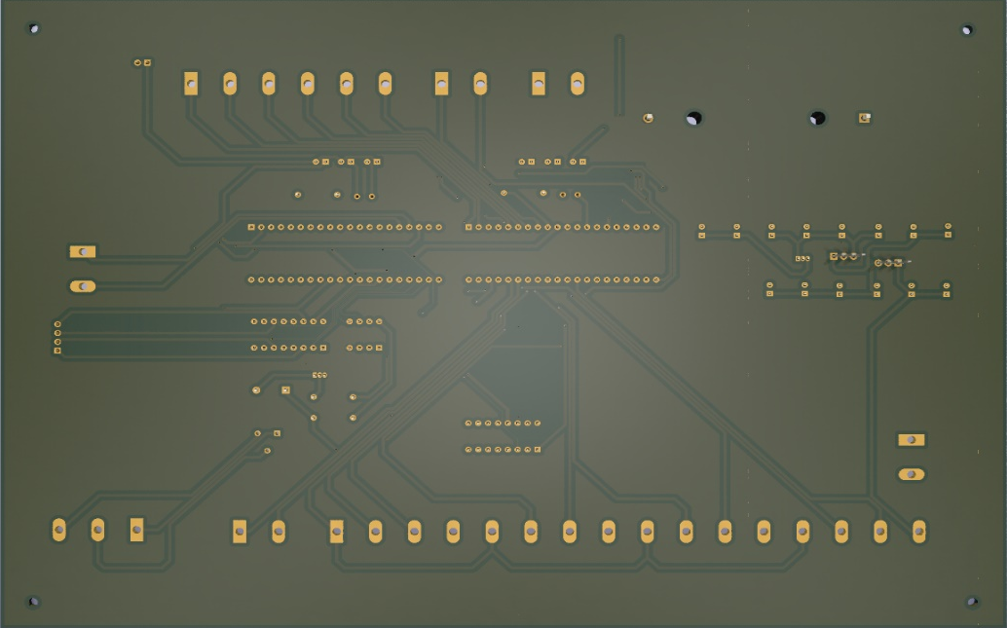
PCB Design

Slide 8
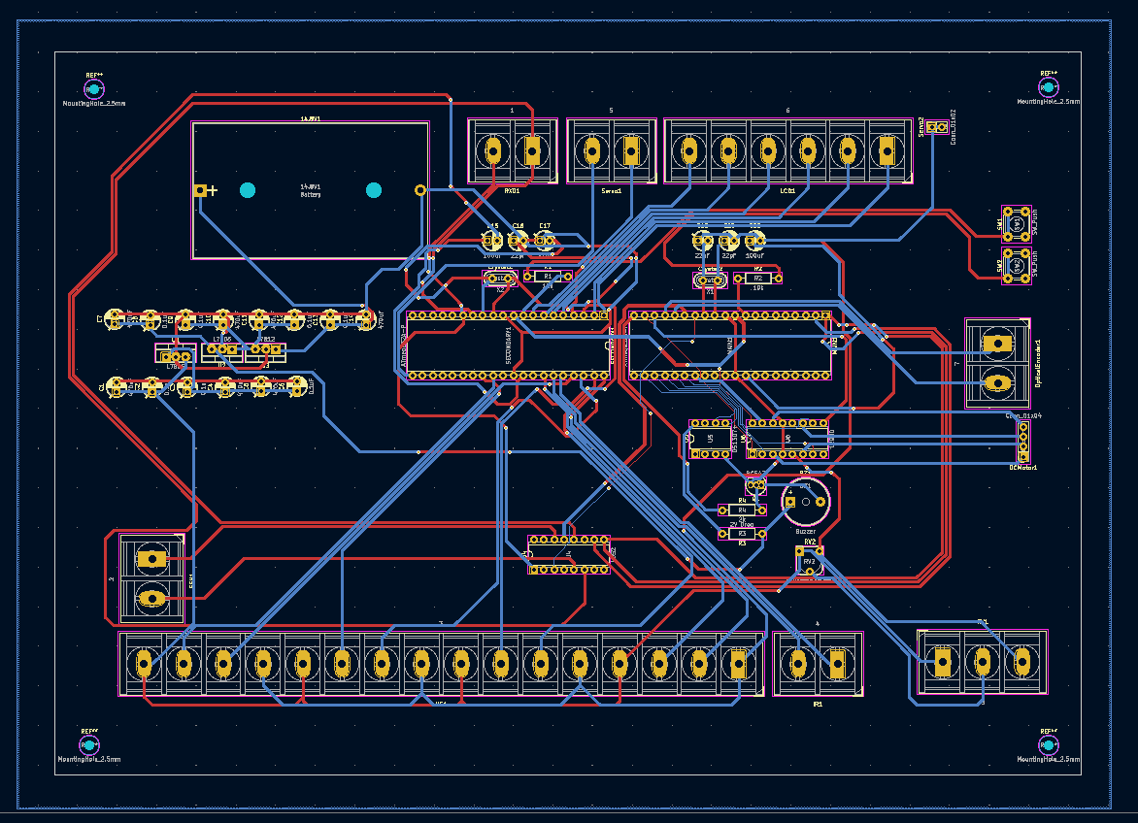
PCB Design

Slide 9
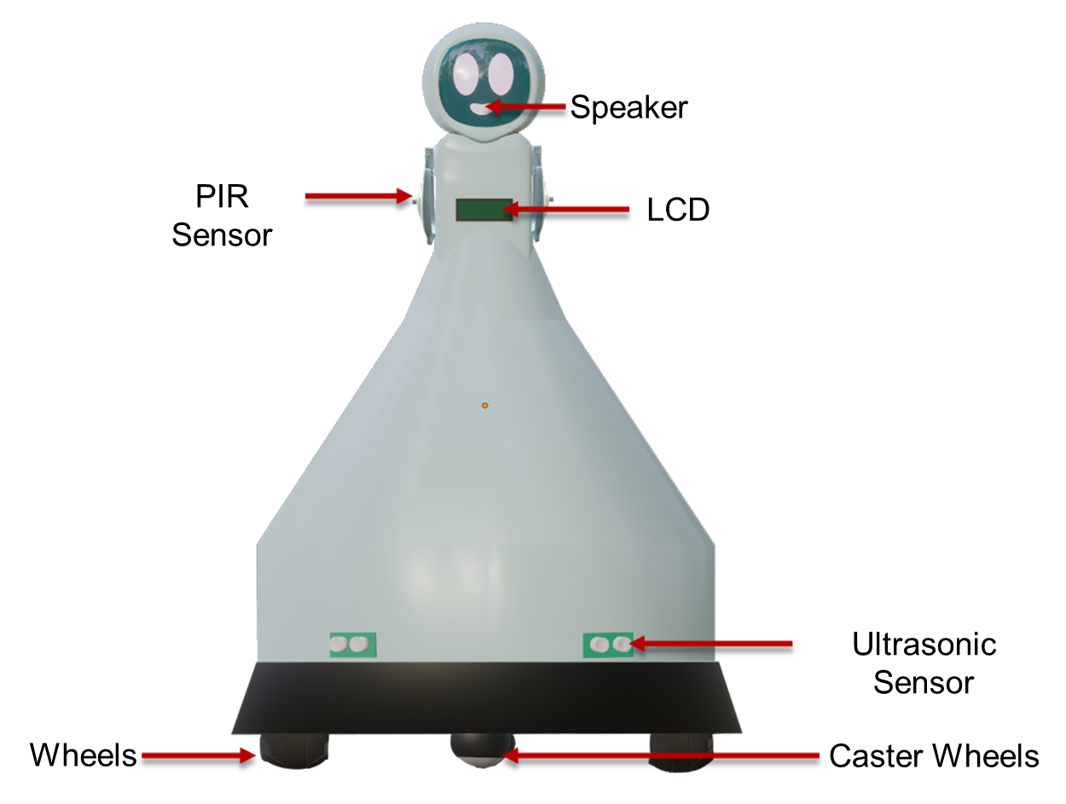
3D Diagram [Front View]

Slide 10
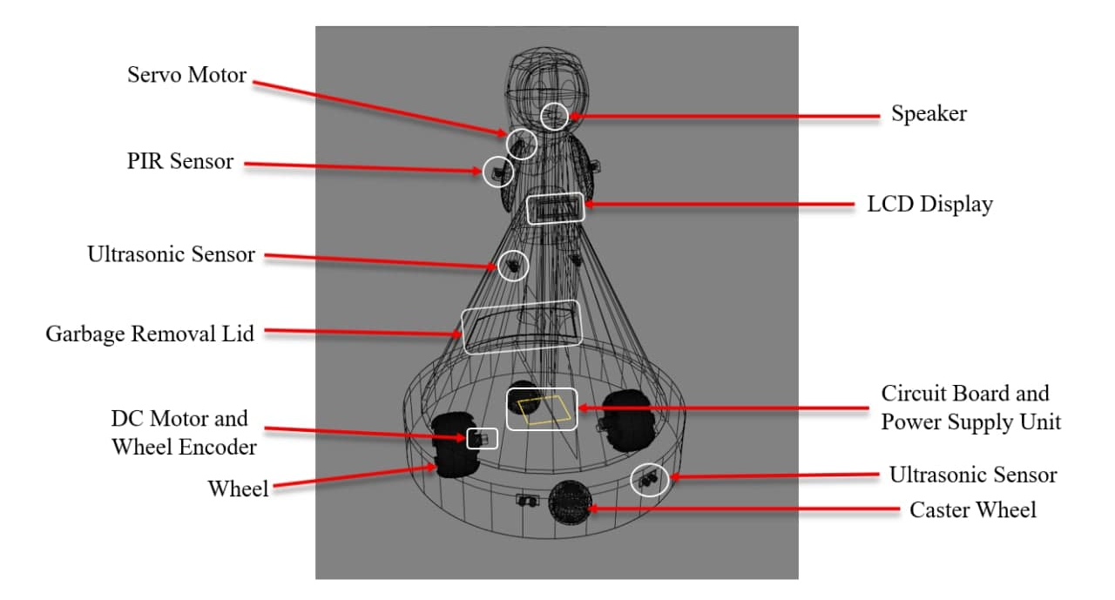
3D Diagram [Inner View]

Slide 11
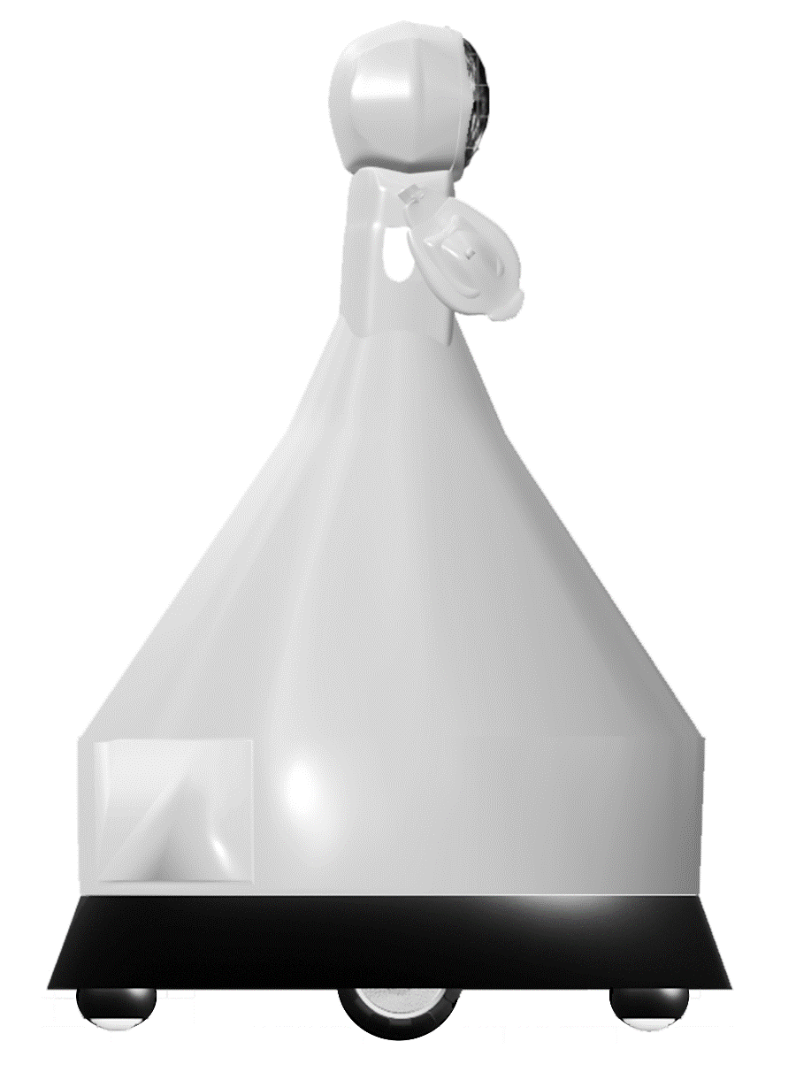
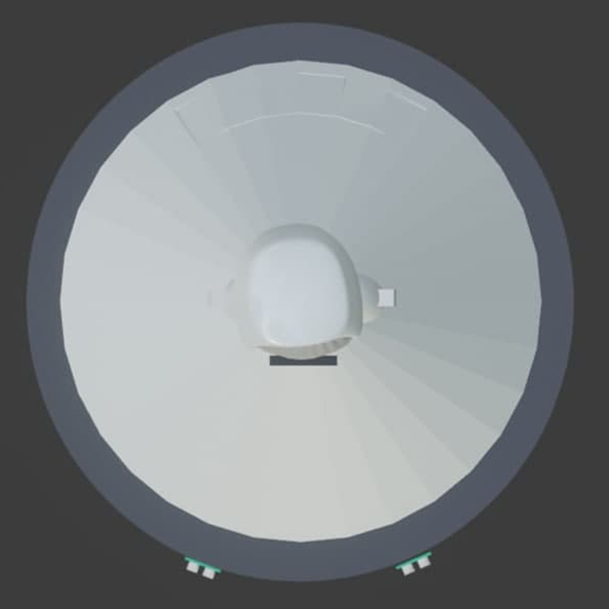
3D Diagram

Slide 12
Animation

Slide 13
Resource Required [Software]
Microchip Studio
Proteus
Blender
KiCAD

Slide 14
Resource Required [Hardware]
Atmega32 Microcontroller
Sensors
PIR Sensors [HC-SR501]
Ultrasonic Sensors [HC-SR04]
Motors
DC Motors
Servo Motors
DC Motor Driver
Wheel Encoder Kit
GSM/GPRS Module
LCD Display
Real Time Clock
Mini Buzzer
Wheels
Steel Ball Swivel Caster Wheel
12V Rechargeable Battery
Battery Charger
Regulators [5V/12V]
Capacitors [10µF/ 470µF]
Resistors
Jumper Wires
Circuit Board

Slide 15
Cost Estimation
Component | Cost per Unit (Rs.) | Quantity | Cost (Rs.)
PIR Sensor HC-SR501 | 360 | 2 | 720
Ultrasonic Sensor Module HC-SR04 | 400 | 4 | 1600
HC-020K Double Speed Measuring Sensor Module with Photoelectric Encoders Kit | 500 | 2 | 1000
SIM900A Module (GSM GPRS) | 2800 | 1 | 2800
DS1307 Real time clock | 250 | 1 | 250
Atmega32A-PU - PDIP | 1370 | 2 | 2740
FS5103B 3kg.cm Standard Servo Motor | 1500 | 2 | 3000
12VDC 200RPM ZGB37Rg High Torque Gear Motor | 1490 | 2 | 2980
L293D Motor Driver Mini Expansion Board | 390 | 1 | 390
1602 LCD Display 16*2 (Blue) | 885 | 1 | 885
5V Mini Buzzer (SP0001) | 80 | 1 | 80
65mm Rubber Tire with Sponge Liner | 480 | 2 | 960
Steel Ball Swivel Caster Wheel | 150 | 2 | 300
12V 2800mAh Lithium Rechargeable Battery | 5500 | 1 | 2500
Battery Charger | 720 | 1 | 720
7805 5V Voltage Regulator | 40 | 1 | 40
7812 12V Voltage Regulator | 35 | 1 | 35
10µF Capacitor | 25 | 2 | 50
470µF Capacitor | 100 | 2 | 200
Resistors | 20 | 10 | 200
Jumper Wires | 175 | 2 | 350
Demultiplexer | 50 | 1 | 50
Circuit Board | 200 | 1 | 200
Total Cost |  |  | 24 050

Slide 16
Test and Implementation
- Individual Contribution -

Slide 17
204071C_Hathnagoda H.W.E.M.J.N
Below hardware components were assigned to me
DC Motor – To move the robot
Wheel Encoders – To calculate moved distance & speed
Buzzer – To sound an alarm
I designed complete circuit diagram.
I helped my group members to understand some coding parts.
I helped to make the literature survey in Interim report.
I helped to integrate the code.
As the leader of the Group 18 I’m coordinating the whole project.

Slide 18
01. DC Motor
Before selecting a suitable DC motor for our project, I calculated the power needed for moving the robot.
r
f
F
mg
θ
Assumptions:
m = 10kg
μ = 0.6
θ = 3°
r = 6.5 cm
v = 13.5cm/s (20RPM)
Efficiency = 70%

Slide 19
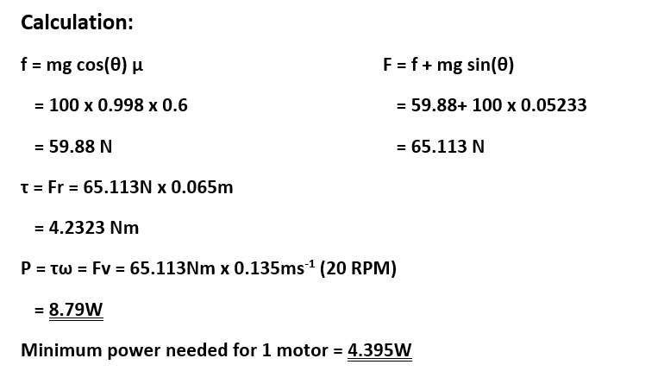
Reduce power by reducing speed if needed.

Slide 20
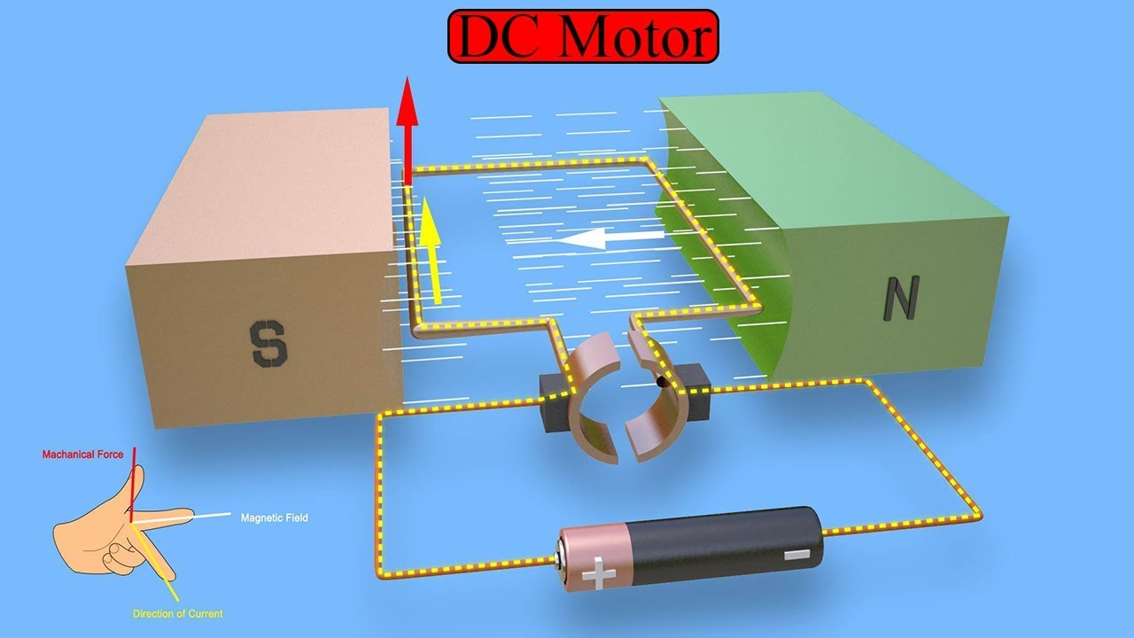
Working Principle
When kept in a magnetic field, current carrying conductor gains torque and develops tendency to move.

Slide 21
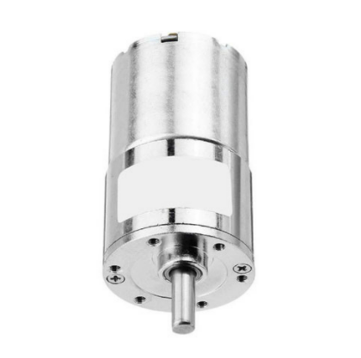
Specifications:
No-load Speed: 200RPM at 12 Volts
Load speed: 158RPM
Power: 7.2W
No-load Current: 0.15A
Load Current: 0.6A
Reduction Ratio: 1: 22
Input Torque = 2.2 kg.cm (0.215754Nm)
Output Torque = 0.215754Nm * 22
= 4.7465Nm > 4.2323Nm

Slide 22
Resources
ZGB37RG-12VDC-200RPM-High-Torque Gear-Motor (duino.lk)
1pcs ZGB37RG Gear Motor DC 12V/24V with GearBox Gearwheel Eccentric Shaft Micro DC Reducer 520 Motor support CW&CCW 2RPM 1000RPM|DC Motor| - AliExpress
https://www.alibaba.com/product-detail/37mm-high-torque-12v-24v-dc_1600509771768.html?spm=a2700.7724857.normal_offer.d_title.1a4f6ff2EKuMCe
Data sheet
正科形象转曲.cdr (zhengkemotor.com)
https://stevenengineering.com/Tech_Support/PDFs/44MOTORS.pdf

Slide 23
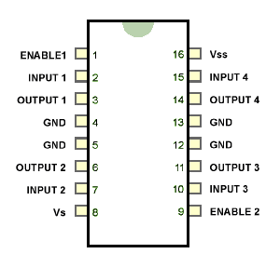
02. L293D motor driver
L293D Driver uses the H-Bridge concept.
Pin Diagram:

Slide 24
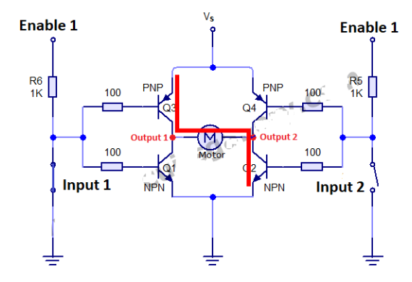
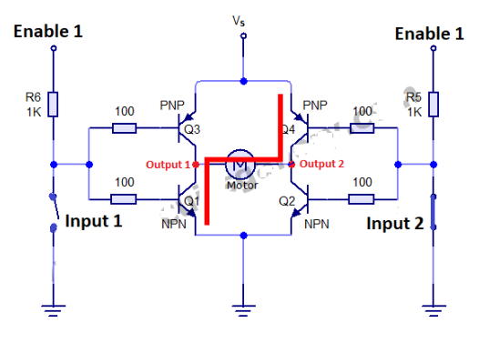
Working Principle
Clockwise
Anti-Clockwise

Slide 25
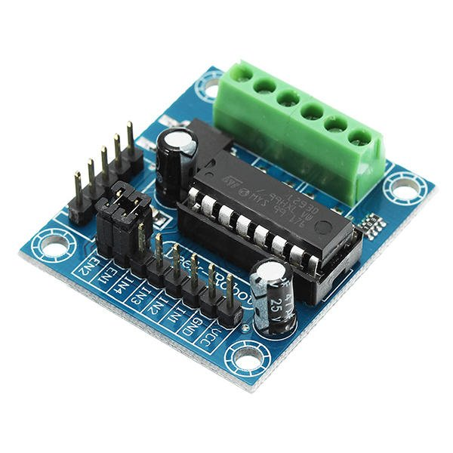
Specifications:
Recommended Voltages :
Vss = 4.5V – 7V Vs = Vss - 36V Vin = 7V Ven = 7V
Can supply MAX 600mA continuous current per channel.
Data sheet
SGS Thomson Microelectronics mXyzuxsr datasheet pdf (datasheetcatalog.com)

Slide 26
Codes:
Motor.h
Motor.c
#include <avr/io.h> #ifndef MOTOR_H #define MOTOR_H #define OC1A_PORT D #define OC1A_PIN PD5 #define OC1B_PORT D #define OC1B_PIN PD4 #define DDR(a) __CONCAT(DDR,a) #define PORT(a) __CONCAT(PORT,a) #define PIN(a) __CONCAT(PIN,a) #define MOTOR_STOP 0 #define MOTOR_CW 1 #define MOTOR_CCW 2 void MotorInit(); void MotorA(uint8_t dir,uint8_t speed); void MotorB(uint8_t dir,uint8_t speed); #endif
#include <avr/io.h> #include <avr/interrupt.h> #include "motor.h" void MotorInit(){ TCCR1A=(1<<COM1A1)|(1<<COM1B1)|(1<<WGM10); TCCR1B=(1<<CS11)|(1<<CS10); DDR(OC1A_PORT)|=(1<<OC1A_PIN); DDR(OC1B_PORT)|=(1<<OC1B_PIN); DDRC|=0X3C; } void MotorA(uint8_t dir,uint8_t speed){ //Direction if(dir == MOTOR_STOP){ PORTC&=(~(1<<PC2)); PORTC&=(~(1<<PC3)); } else if(dir == MOTOR_CCW){ PORTC&=(~(1<<PC2)); PORTC|=(1<<PC3); } else if(dir == MOTOR_CW){ PORTC&=(~(1<<PC3)); PORTC|=(1<<PC2); } | //Speed uint8_t sreg=SREG; cli(); OCR1A=speed; SREG=sreg; } void MotorB(uint8_t dir,uint8_t speed){ //Direction if(dir == MOTOR_STOP){ PORTC&=(~(1<<PC4)); PORTC&=(~(1<<PC5)); } else if(dir == MOTOR_CCW){ PORTC&=(~(1<<PC4)); PORTC|=(1<<PC5); } else if(dir == MOTOR_CW){ PORTC&=(~(1<<PC5)); PORTC|=(1<<PC4); } //Speed uint8_t sreg=SREG; cli(); OCR1B=speed; SREG=sreg; }

Slide 27
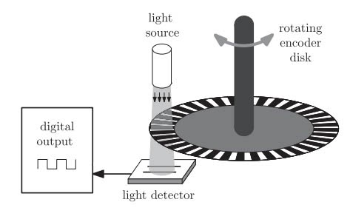
03. Wheel Encoders (Optical Encoders)
Used to count the number of times the motor (left or right) has rotated.
Converts light piles to an electric signal.
Represents a particular pattern.
Can calculate position, direction and velocity.

Slide 28

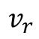
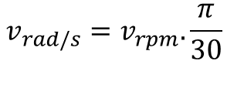
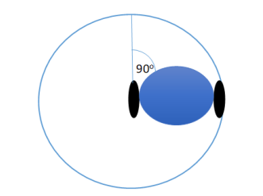
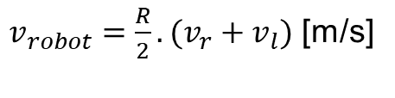

Working Principle: Convert Tick to rpm
$$Speed =\frac{PULSE COUNT}{PPR} . \frac{1}{∆t}$$[rpm]
R
L
Robot speeds

Slide 29
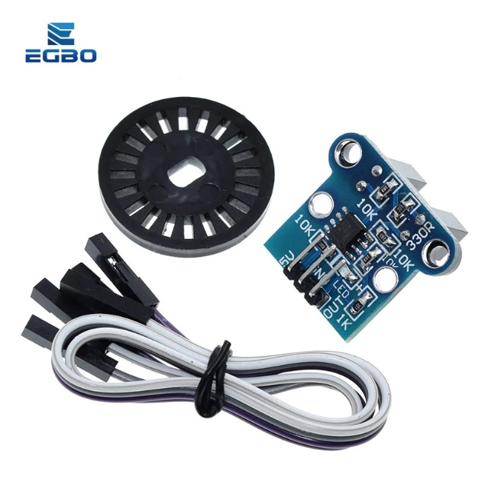
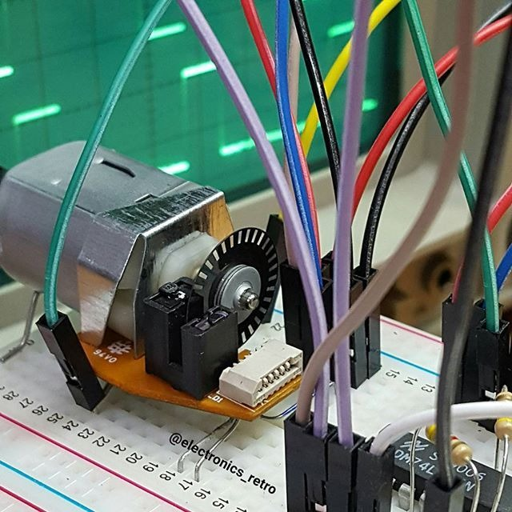
HC-020K Double Speed Measuring Sensor Module with Photoelectric Encoders Kit
Module Working Voltage: 4.5-5.5V
Launch tube current: < 20mA
Data sheet
HC-020K.pdf (mrelectrobot.com)

Slide 30
Codes:
Main.c
#define F_CPU 16000000UL #include <stdint.h> #include <avr/delay.h> #include <stdlib.h> #include <avr/interrupt.h> #include <avr/io.h> #include <util/delay.h> #include "motor.h" #include "buzzer.h" volatile uint16_t countLeft = 0; volatile uint16_t countRight = 0; uint32_t disLeft = 0; uint32_t disRight = 0; uint32_t speedRight; uint32_t speedLeft; #define Init_ticks 100 #define Time_Interval 0.01 #define PPR 20.0 | #define R 6.5 #define WHEELCIRCUMFERENCE 40.84 #define GearRatio 73.6 void EncoderInit(void); void init_system(); int main(){ init_system(); while(1){ if (disLeft <= 1000){ if(disLeft < 500){ MotorA(MOTOR_CW,255); MotorB(MOTOR_CCW,255); uint8_t wheelspeed; if(disLeft > 380){ wheelspeed = 10 * ((500 - disLeft)/10); if(wheelspeed < 5){ wheelspeed = 0; } MotorA(MOTOR_CW,wheelspeed); MotorB(MOTOR_CCW,wheelspeed); }

Slide 31
} else if (500 <= disLeft && disLeft < 580) { MotorA(MOTOR_STOP,0); MotorB(MOTOR_CCW,150); } else if(disLeft == 580) { MotorA(MOTOR_STOP,0); MotorB(MOTOR_STOP,0); //Start Moving Forward MotorA(MOTOR_CW,255); MotorB(MOTOR_CCW,255); } else{ //Start Moving Forward MotorA(MOTOR_CW,255); MotorB(MOTOR_CCW,255); } } else{ MotorA(MOTOR_STOP,0); MotorB(MOTOR_STOP,0); buzzer(); } } return 0; } void CheckEncoders(void){ disRight += (countRight/PPR) * WHEELCIRCUMFERENCE; disLeft += (countLeft/PPR) * WHEELCIRCUMFERENCE; speedRight = ((countRight/(Time_Interval*GearRatio))/PPR)*60.0; // Speed equation speedLeft= ((countLeft/(Time_Interval*GearRatio))/PPR)*60.0; countLeft = 0; TCNT0 = Init_ticks; } | void Timer0_Start(void){ TCNT0 = Init_ticks; /* Load TCNT0, count for 10ms*/ TCCR0 = (1<<CS02) | (1<<CS00); /* Start timer0 with /1024 prescaler*/ sei(); TIMSK=(1<<TOIE0); /* Enable Timer0 overflow interrupts */ } ISR(TIMER0_OVF_vect){ //reading Encoders CheckEncoders(); } ISR(INT0_vect){/* Interrupt Service Routine for INT0 to count each pulse from encoder */ countRight++; } ISR(INT1_vect){ /* EX PIN ISR to count each pulse from encoder */ countLeft++; } void init_system(){ //Initialize motor subsystem MotorInit(); EncoderInit(); GICR = 1<<INT0; /* Enable INT0*/ MCUCR = 1<<ISC01 | 1<<ISC00; GICR = 1<<INT1; /* Enable INT1*/ MCUCR = 1<<ISC11 | 1<<ISC10; sei(); /* Enable Global Interrupt */ Timer0_Start(); }

Slide 32
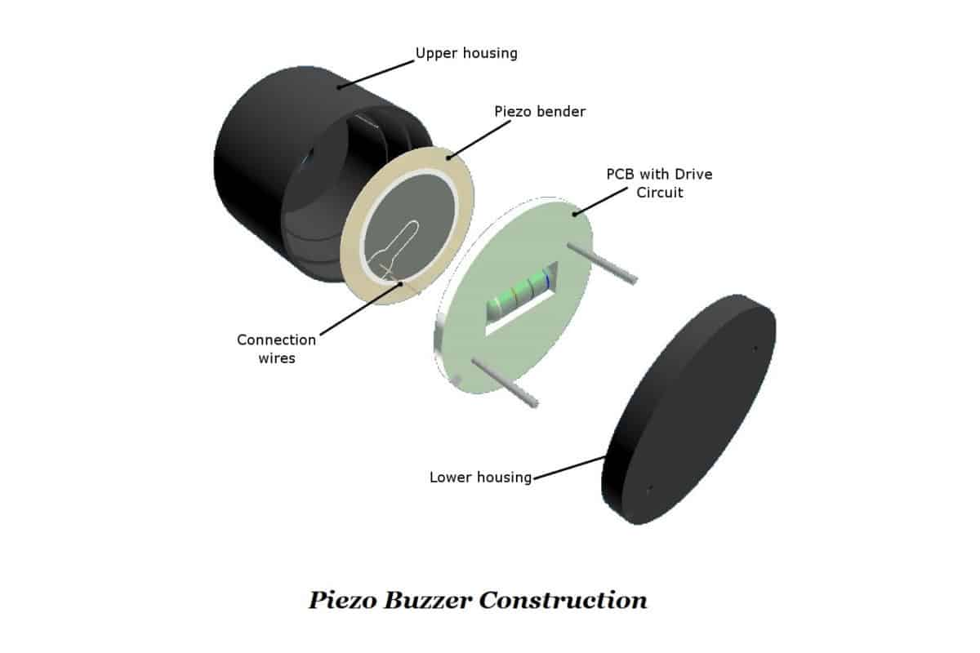
04. Piezoelectric Active Buzzer
When a voltage is applied across the two electrodes, the piezoelectric material mechanically deforms due to the applied voltage.
This movement of the piezo disk within the buzzer creates sound.

Slide 33
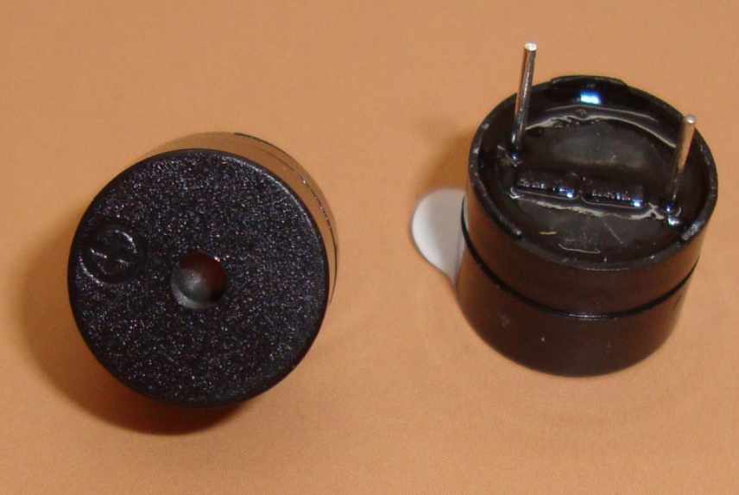
Specifications:
Rated voltage – 6V
Operating voltage – 4-8V
Current(the MAX) – 30 mA
Diameter: 12mm Height: 9.5mm
Datasheet - https://www.farnell.com/datasheets/2171929.pdf

Slide 34
Codes:
Buzzer.h
#ifndef BUZZER_H_ #define BUZZER_H_ void buzzer(){ DDRD |= (1 << PIND6); //make b0 output pin while (1){ PORTD |= (1 << PIND6); //b0 1 _delay_ms(10); PORTD &= ~(1 << PIND6); //b0 0 _delay_ms(10); } }

Slide 35
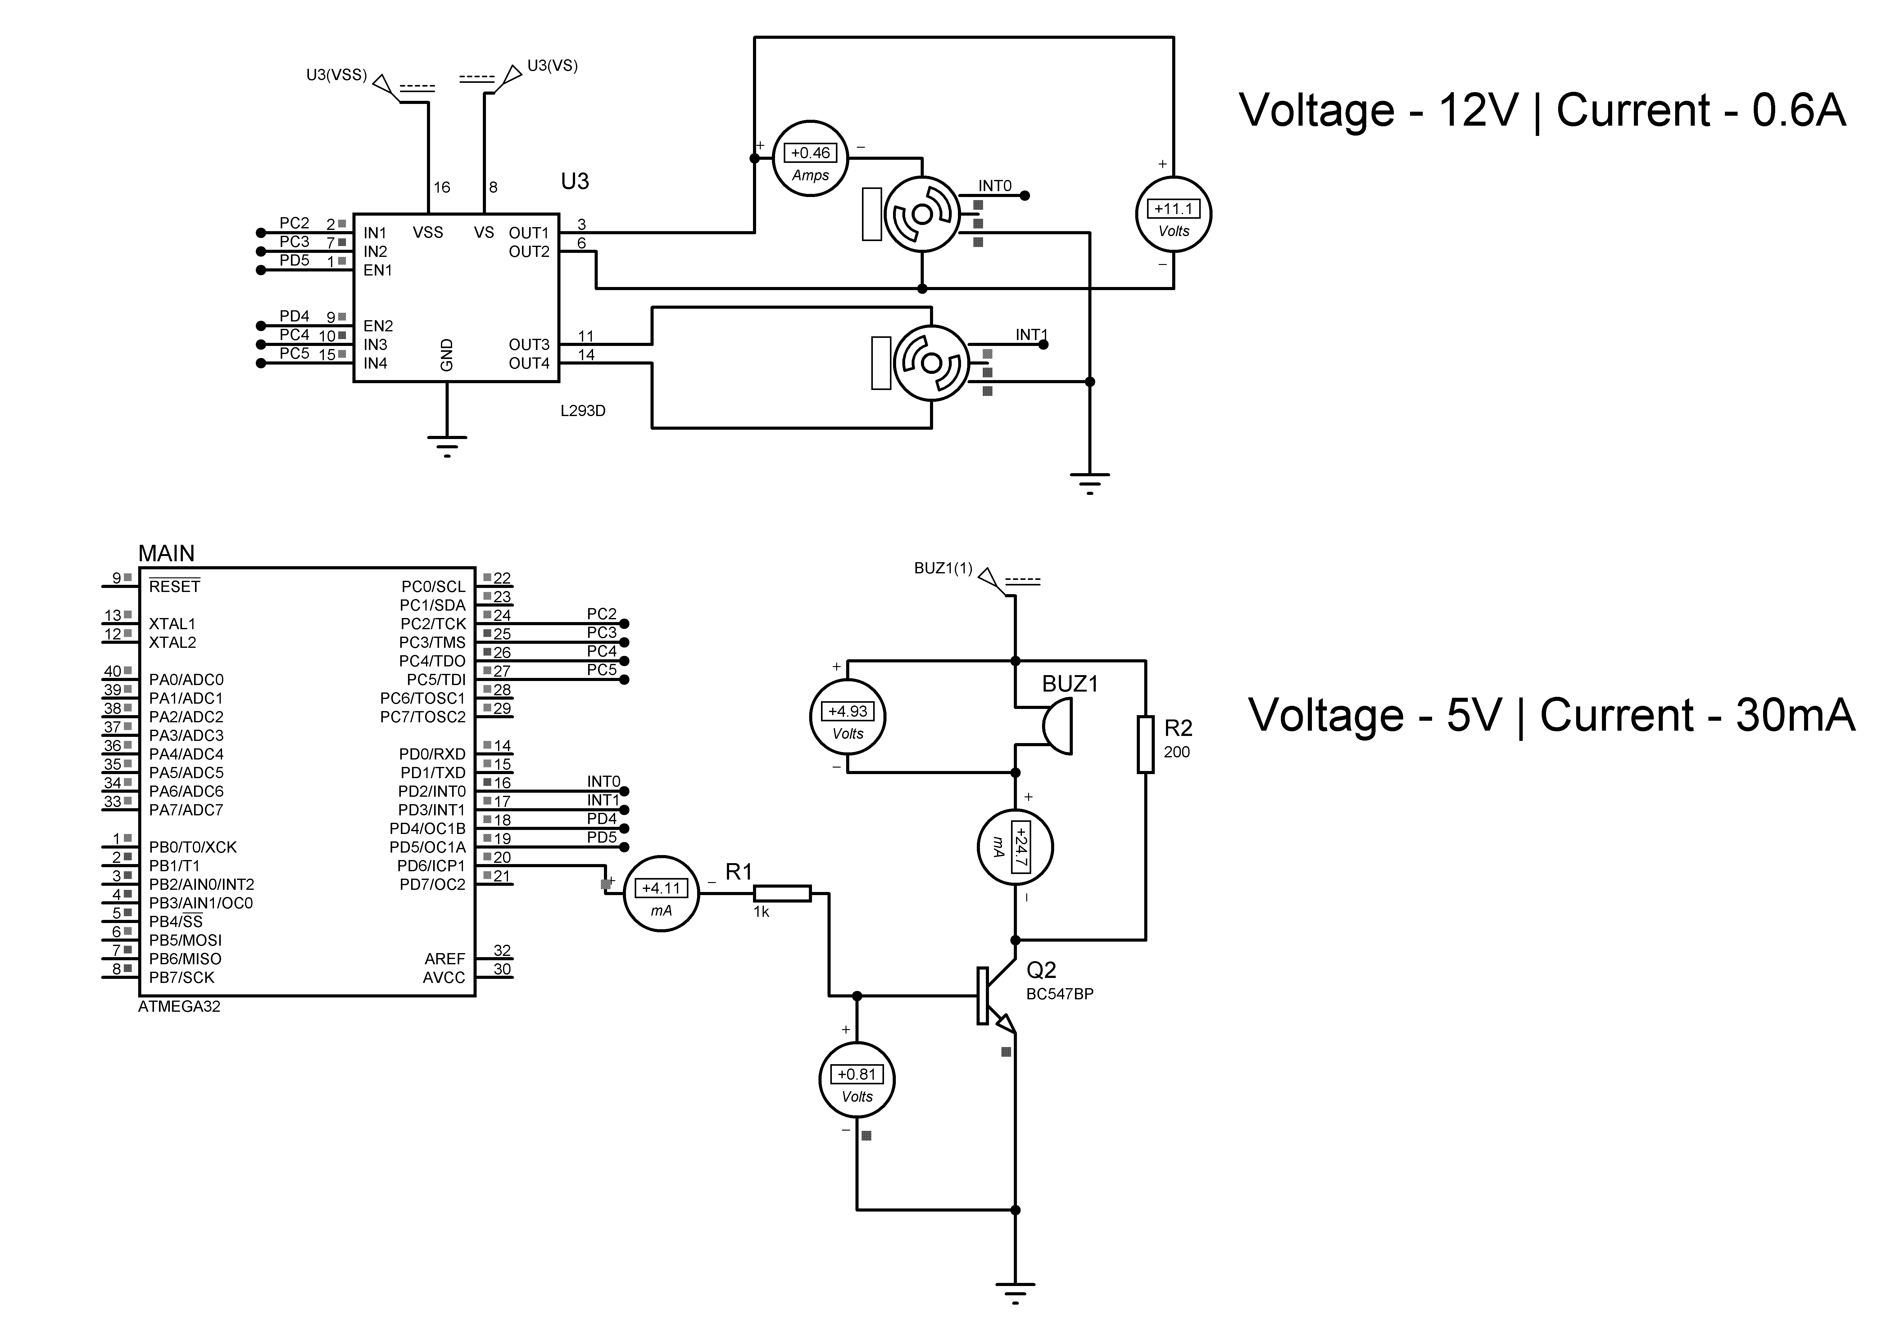
Circuit Diagram:

Slide 36
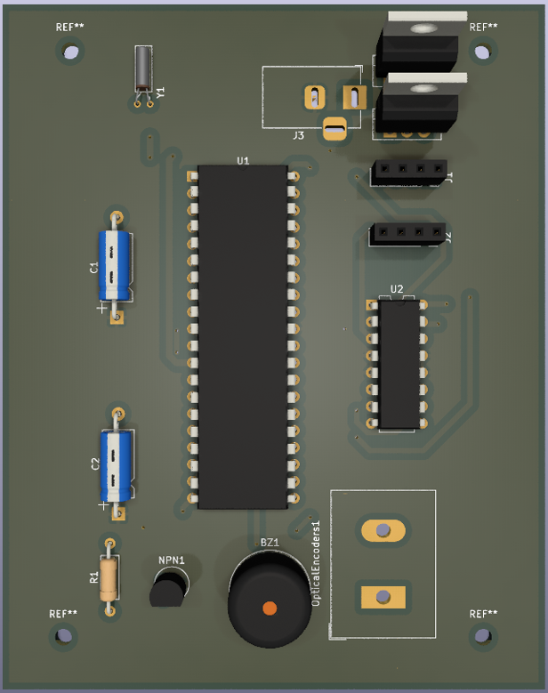
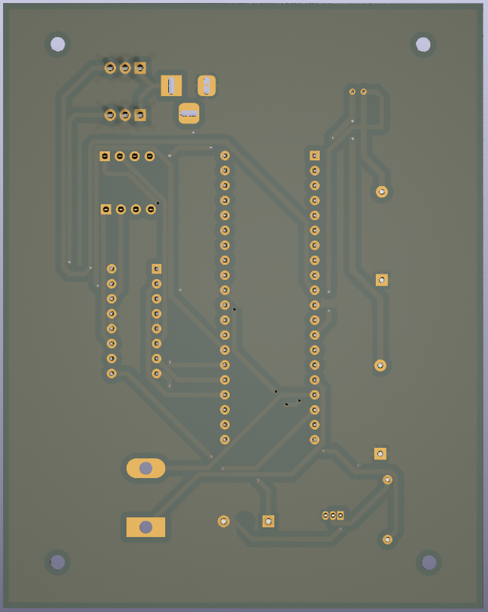
PCB Design:

Slide 37
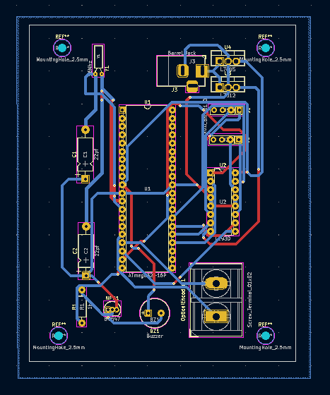
PCB Design:

Slide 38
204084T_Jayasekara J.P.I.A.
01. PIR Sensor
Detect hand movements for lids opening process.
02. Robot Navigation Part
03. 3D Modeling
Created the 3D diagram of the Trash Robot by using Blender Software.
04. PCB Design.
Helped to prepare the project proposal, report and presentation.
Helped to integrate the full code and finalized the circuit diagram.
Helped team members to design the individual PCB parts.

Slide 39
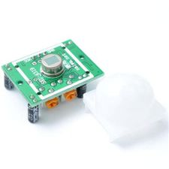
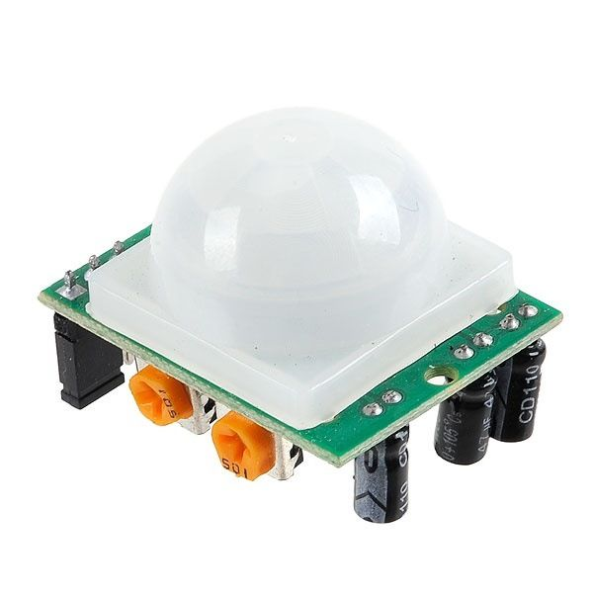
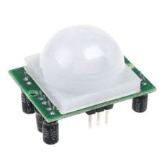
01. PIR Sensor

Slide 40
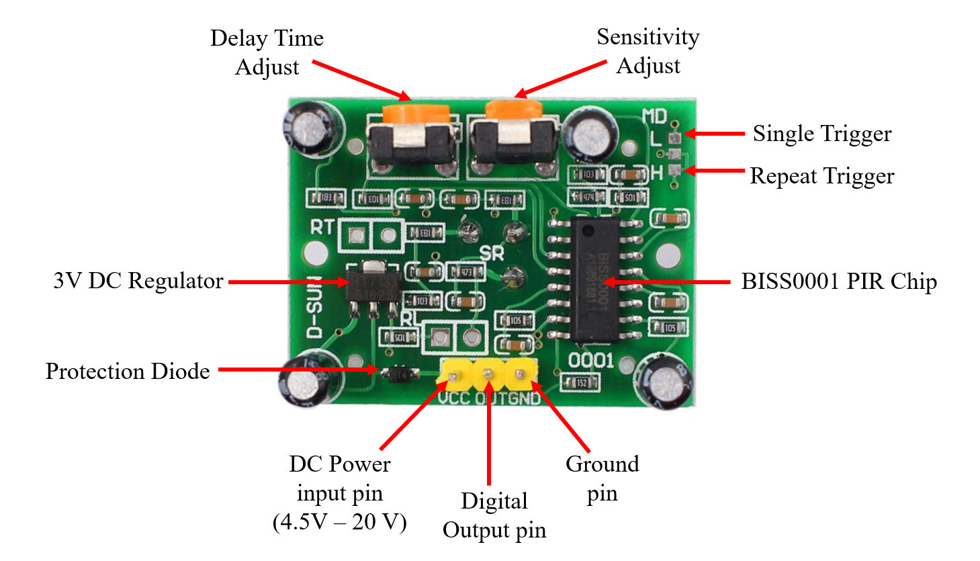

Slide 41
Specifications:
Maximum Voltage: 20 V
Maximum Current: 65 mA
Operating voltage range (DC): 4.5 V - 20 V
Quiescent current: <50µA
Level output (TTL output): High - 3.3 V / Low - 0 V
Sensitivity range: Up to 6 meters - 110° x 70° detection range
Delay time: 3s to 5min (adjustable)
Block time: 2.5s (default)

Slide 42
Trigger methods: L - disable repeat trigger, H - enable repeat trigger
Operation temperature: -15°C to +70°C
Lens size: Diameter - 23mm (default)
Board dimensions: 32mm x 24mm
Datasheet
Datasheets - Files - Document Management System- University of Moratuwa (uom.lk)

Slide 43
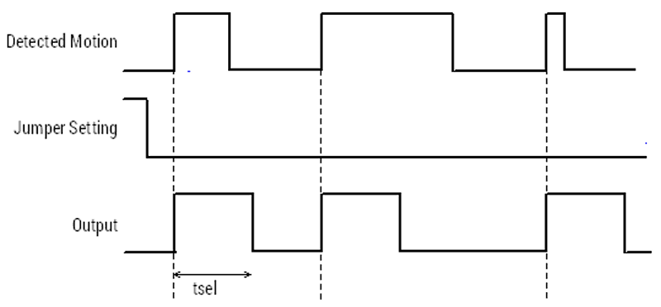
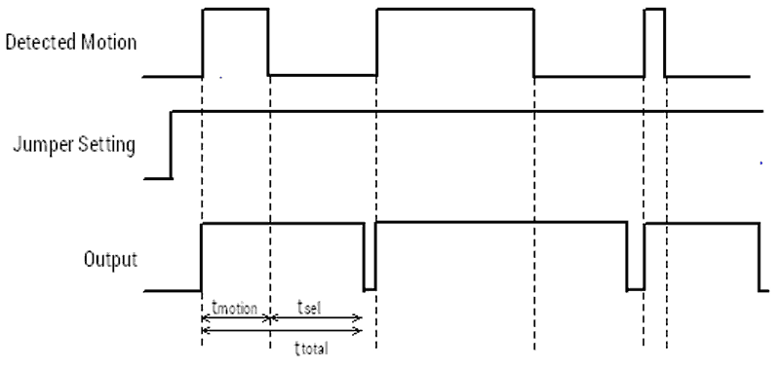
Working Principle:
Single Trigger Mode Timing Diagram
Repeat Trigger Mode Timing Diagram

Slide 44
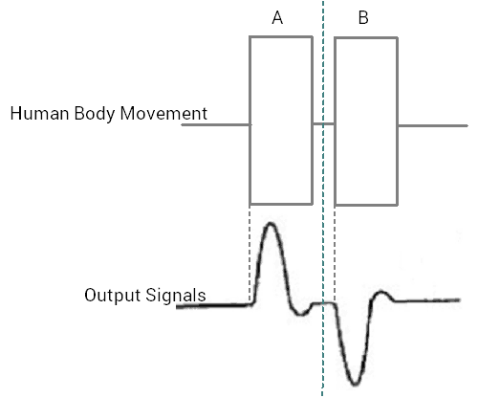
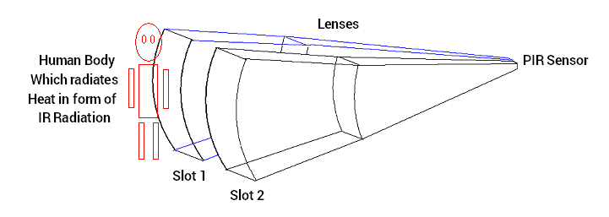
Differential changes between two slots:

Slide 45
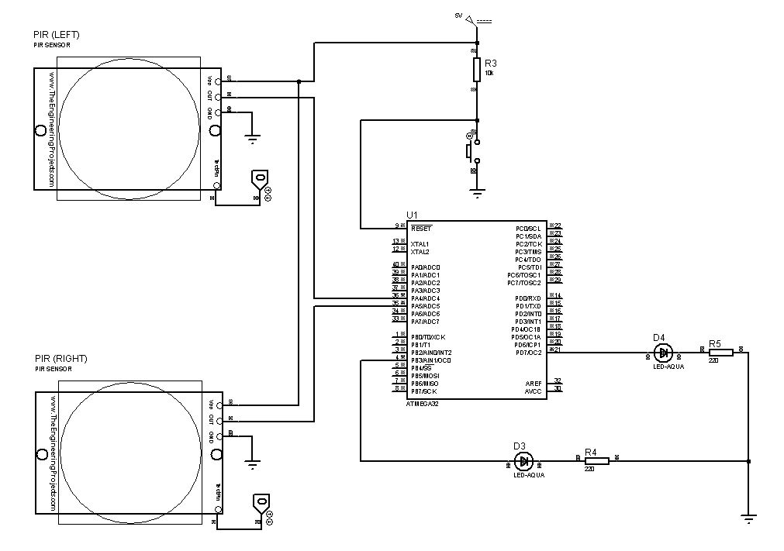
Circuit Diagrams:

Slide 46
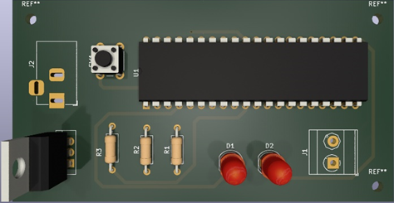
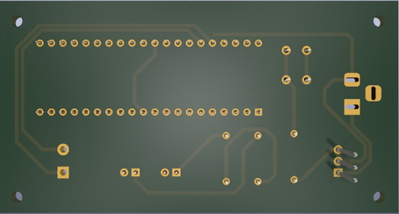
PCB Design:

Slide 47
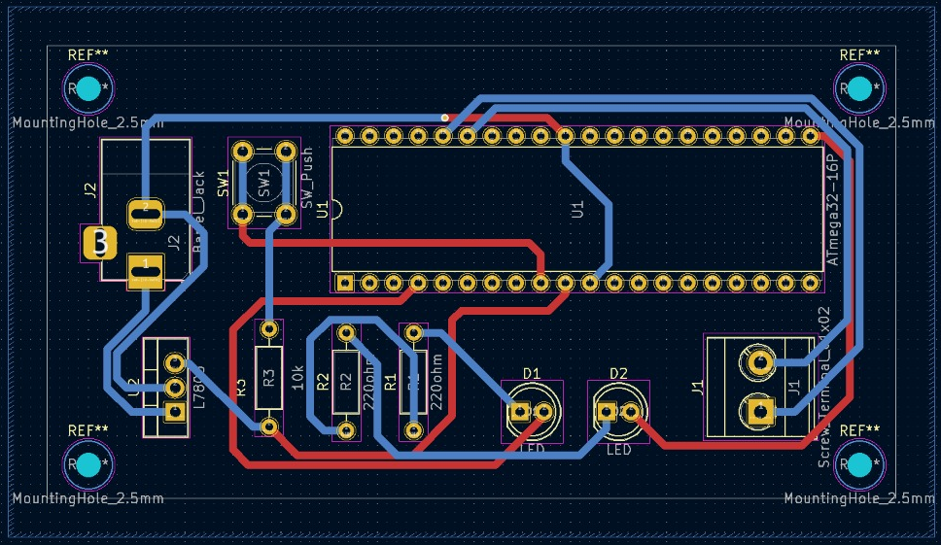
PCB Design:

Slide 48
Code:
#include <avr/io.h> #define F_CPU 16000000UL int main(void) { DDRB = DDRB | (1<<3); //Make PB3 as output pin DDRD = DDRD | (1<<7); //Make PD7 as output pin DDRA = DDRA & (~(1<<4)); //Make PA4 as input pin DDRA = DDRA & (~(1<<5)); //Make PA5 as input pin while (1) { if (PINA & (1<<4)){ PORTB = PORTB | (1<<3); } else{ PORTB = PORTB & (~(1<<3)); } if (PINA & (1<<5)){ PORTD = PORTD | (1<<7); } else{ PORTD = PORTD & (~(1<<7));} }

Slide 49
02. Robot Navigation
A* search algorithm. (Previous method)
Finding the lowest cost path between starting node and ending node of the given map.
Path given by using Wheel Encoder. (Present method)

Slide 50
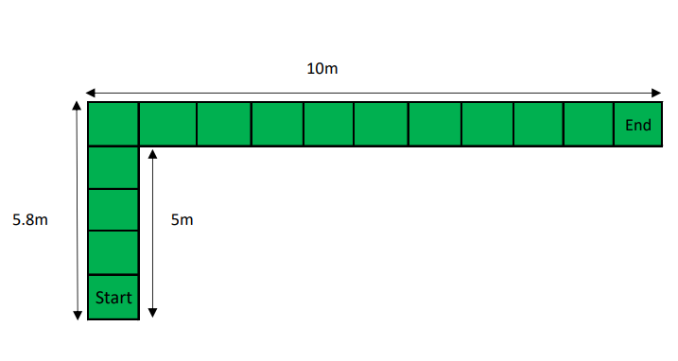
Code:
if (disLeft <= 1580){ if(disLeft < 500){ MotorA(MOTOR_CW,255); MotorB(MOTOR_CCW,255); uint8_twheelspeed; if(disLeft > 380){ wheelspeed = 10 * ((500 - disLeft)/10); if(wheelspeed < 5){ wheelspeed = 0; } MotorA(MOTOR_CW,wheelspeed); MotorB(MOTOR_CCW,wheelspeed); } } else if (500 <= disLeft && disLeft < 580){ MotorA(MOTOR_STOP,0); MotorB(MOTOR_CCW,150); } | else if(disLeft == 580){ MotorA(MOTOR_STOP,0); MotorB(MOTOR_STOP,0); //Start Moving Forward MotorA(MOTOR_CW,255); MotorB(MOTOR_CCW,255); } else{ //Start Moving Forward MotorA(MOTOR_CW,255); MotorB(MOTOR_CCW,255); } } else{ MotorA(MOTOR_STOP,0); MotorB(MOTOR_STOP,0); }

Slide 51
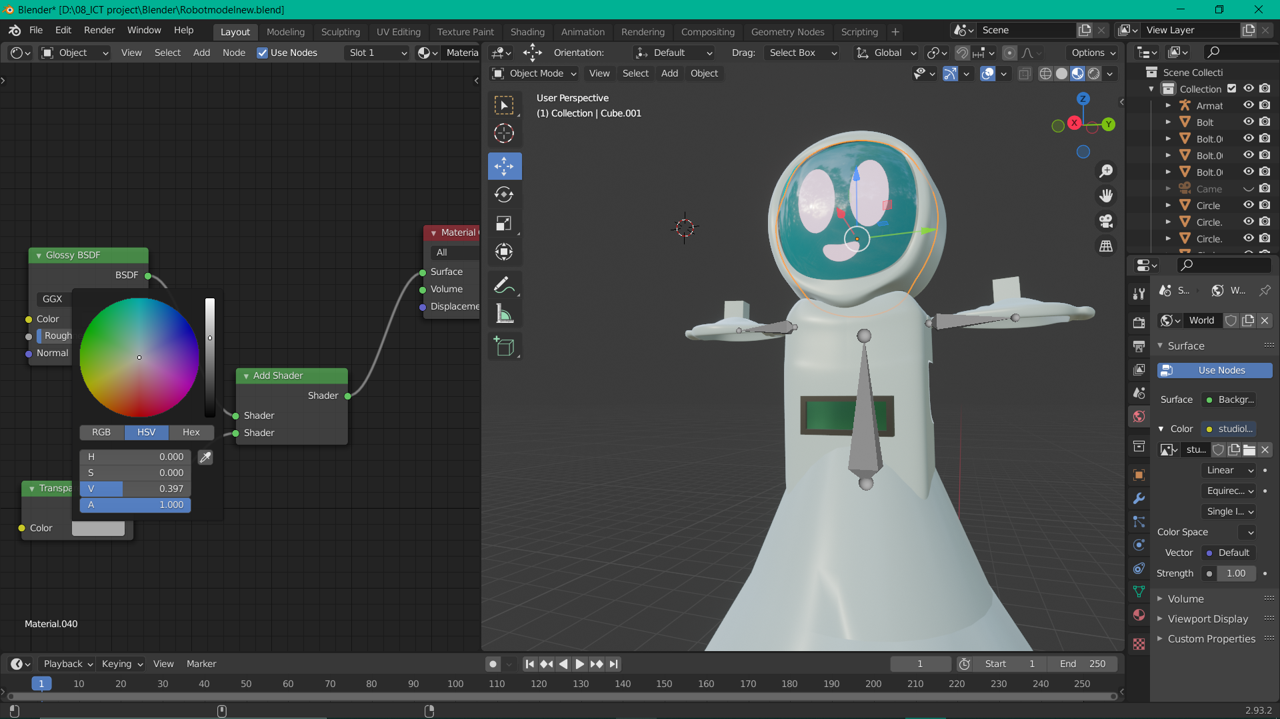
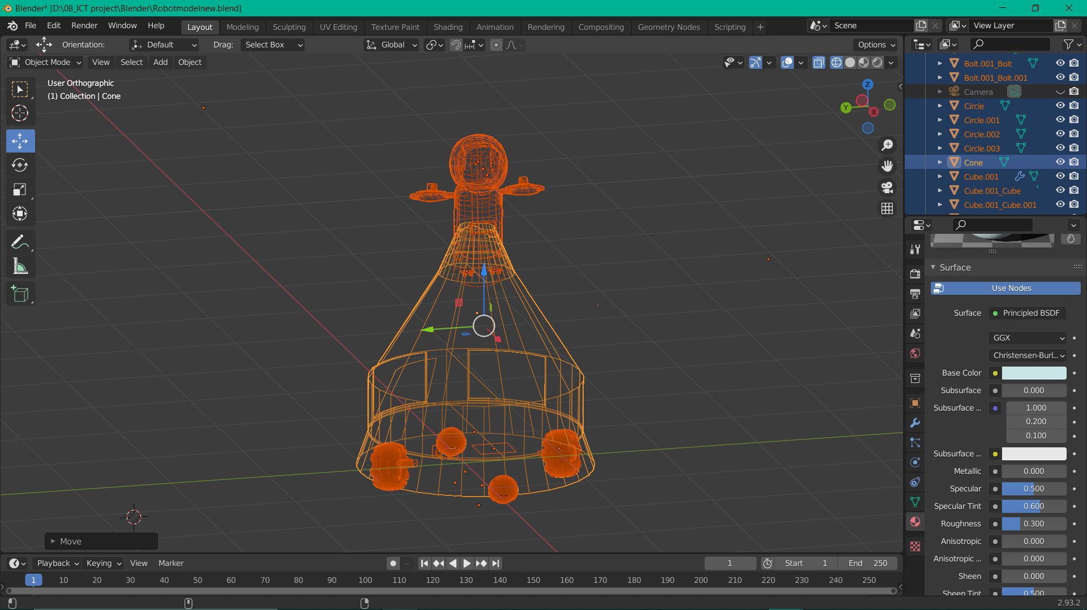
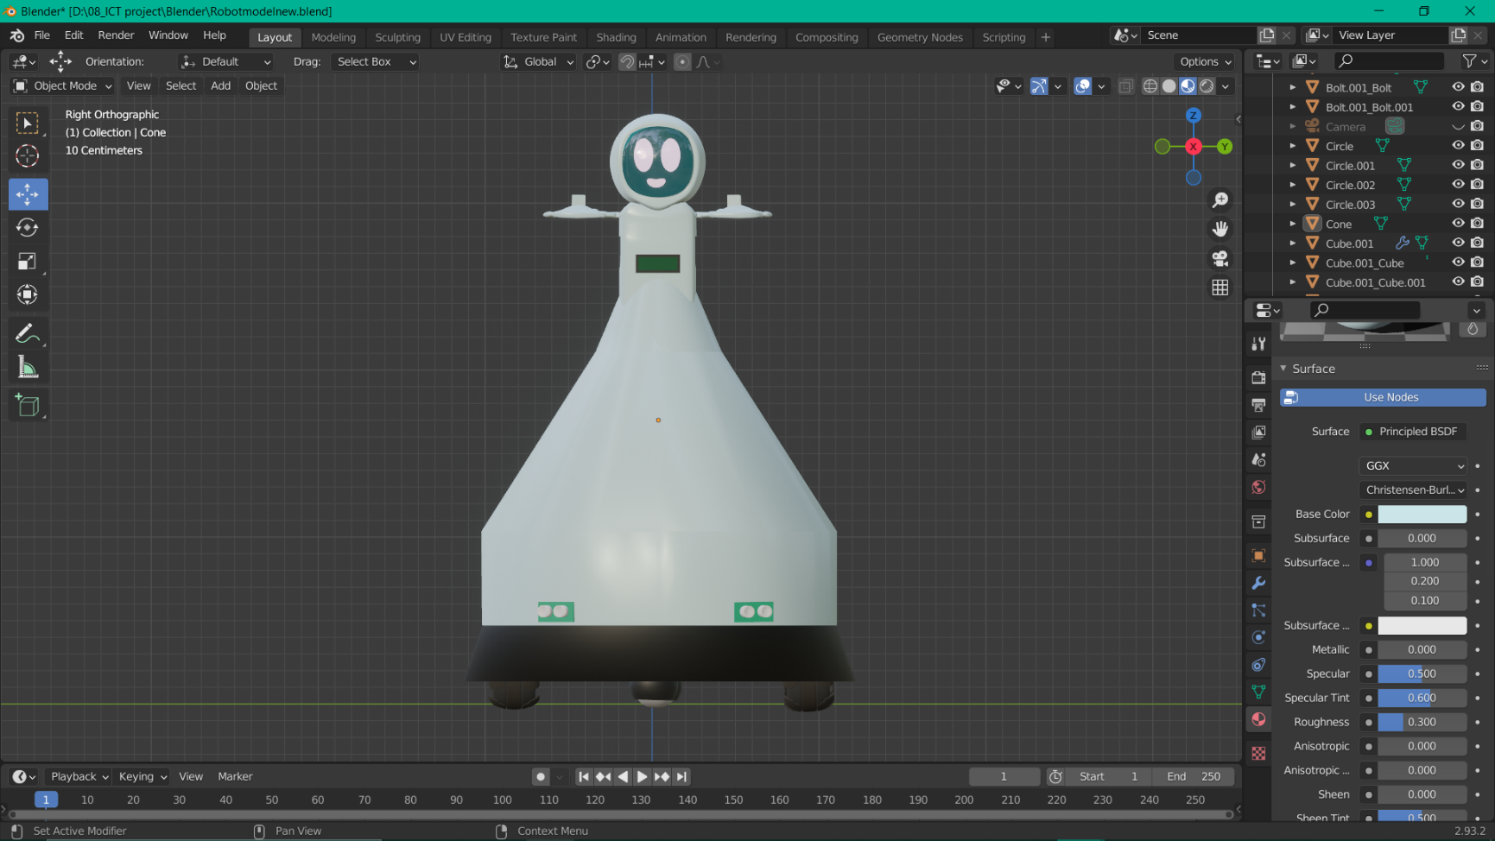
03. 3D Modeling
Created the 3D diagram of the trash robot by using Blender Software.

Slide 52
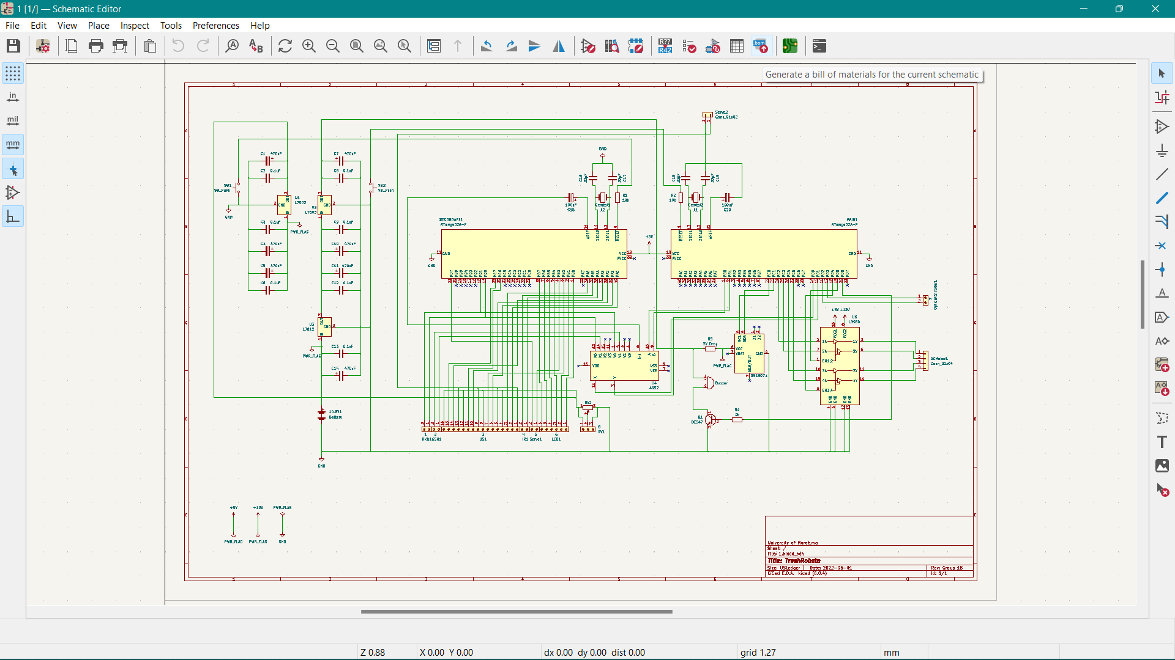
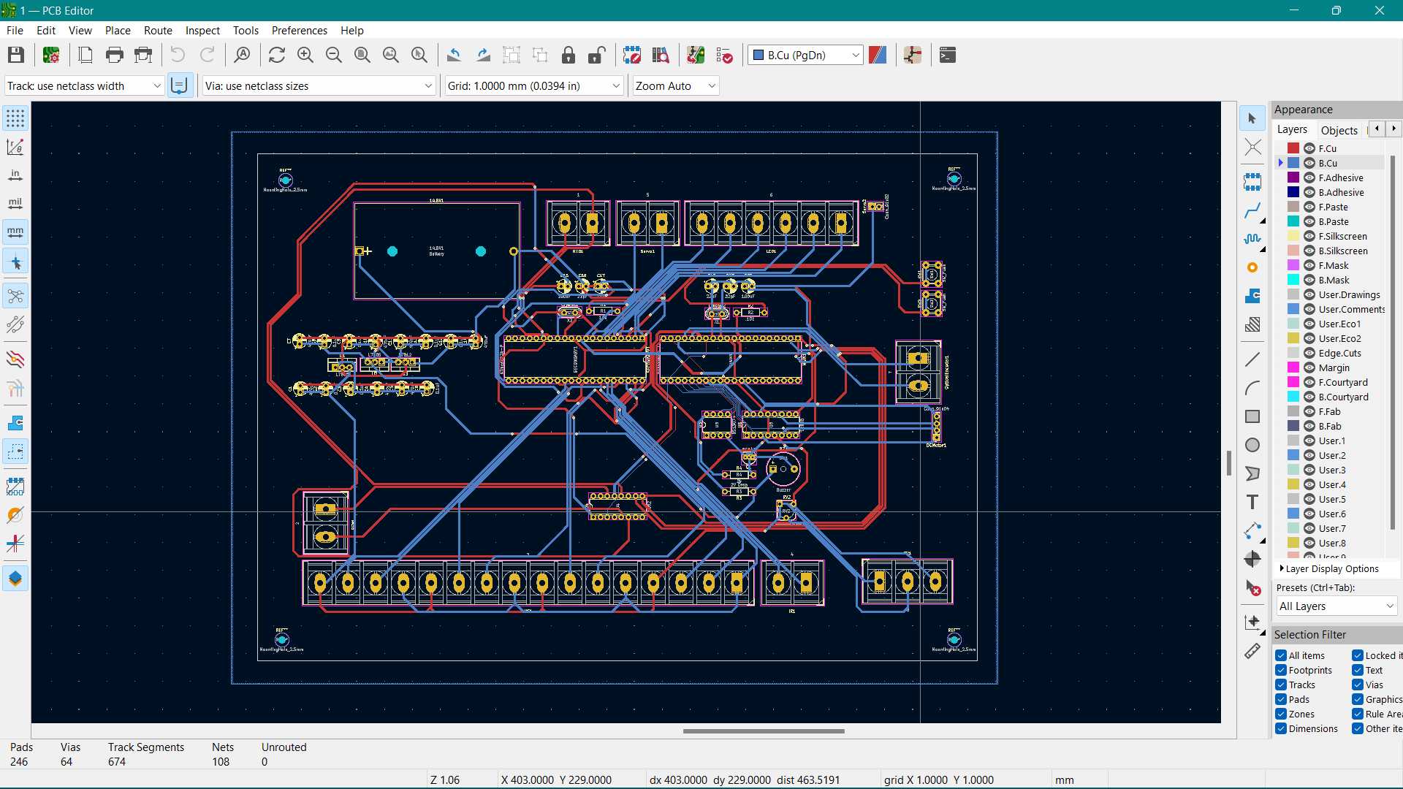
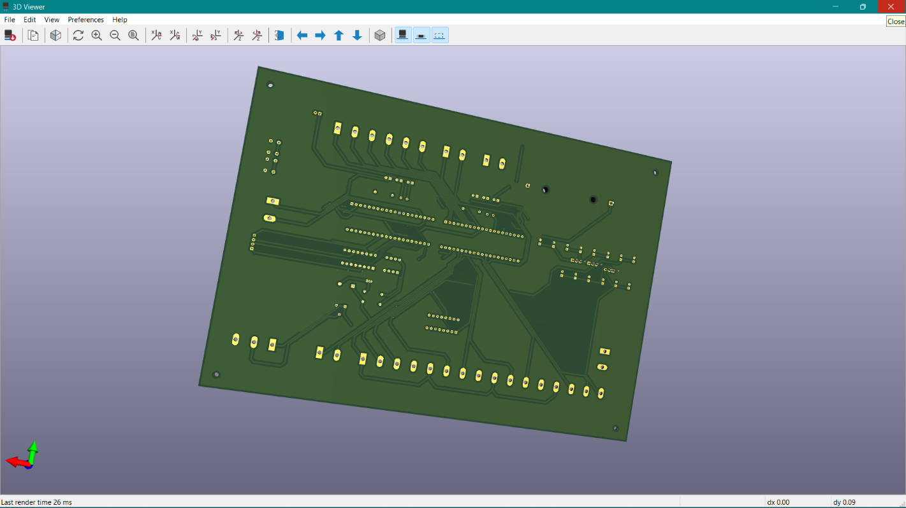
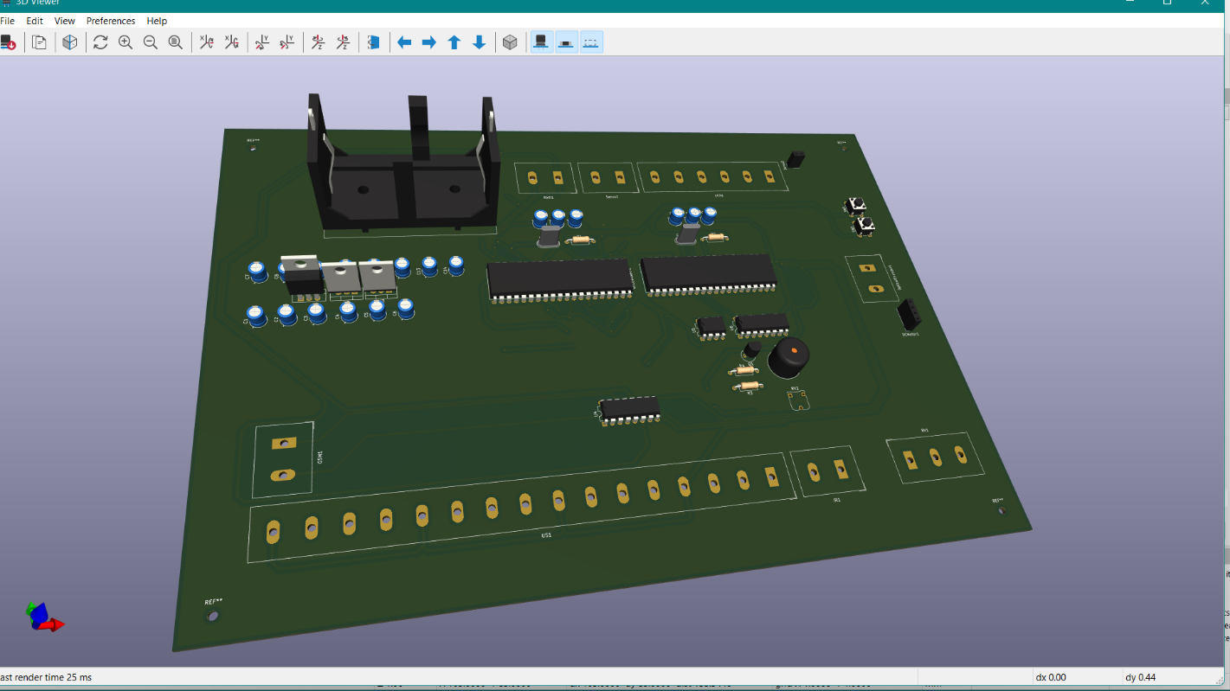
04. PCB Designing
Design full PCB and help team members to design individual PCBs.

Slide 53
204118E_Madhushika B.A.E
01. LCD Display
Display the trash level of each bin
02. Ultrasonic Sensor
Measure the trash level of separate bins
Obstacle avoidance (Detect the obstacles)
Documentation: Proposal, Report & Presentation
Full code combine & Connect power supply to components

Slide 54



01. LCD
VSS (Ground)
VDD (Power)
VEE (Contrast)
RS (Register Select)
RW (Read/Write)
E (Enable)
D0-D7 (Data Pins)
A/K (Backlights)

Slide 55

Pin Description:

Slide 56
Specifications:
Maximum Voltage: 5.3 V
Maximum Current: 3.3 mA
Operating voltage (DC): 4.7 V - 5.3 V
Operating current (without backlights): 1 mA
PCB size: 80L x 36W x 10H mm
Display bezel: 72 x 25mm
Number of columns: 16
Number of rows: 2
Number of characters: 32

Slide 57
Number of pins: 16
Pixel box of one character: 5x8 pixels
Font size of a character: 0.125 width x 0.200 height
Working in 4-bit or 8-bit mode.
Resources
LCD 16x2 Display Module | Sensors & Modules (electronicwings.com)
LCD interfacing with ATMEGA32 AVR MICROCONTROLLER (microcontrollerslab.com)
LCD 16X2 : Pin Configuration, Commands, Interfacing & Its Applications (watelectronics.com)
Datasheet
Datasheets - Files - Document Management System- University of Moratuwa (uom.lk)

Slide 58
Codes:
LCD.h
#ifndef LCD_H_INCLUDED #define LCD_H_INCLUDED #define RS PB0 // Register Select pin on PB0 #define EN PB1 // Enable pin on PB0 // Function Prototypes void LCD_Init (void); void LCD_Command(unsigned char); void LCD_Print (char *); void LCD_Clear(); void LCD_SetCursor(unsigned char, unsigned char); void LCD_Init (void){ DDRB = 0b11111111; _delay_ms(15); LCD_Command(0x02); // 4 Bit Mode LCD_Command(0x28); // 2 lines, 5x8 matrix,4-bit mode LCD_Command(0x0c); // Display on, cursor off LCD_Command(0x06); // Shift the cursor to right LCD_Command(0x01); // Clear the display _delay_ms(2); } | void LCD_Command(unsigned char cmnd){ PORTB = (PORTB & 0x0F) | (cmnd & 0xF0); // Send upper nibble PORTB &= ~(1<<RS); // RS=0, command reg. PORTB |= (1<<EN); // Enable=1 _delay_us(1); PORTB &= ~(1<<EN); // Enable=0 _delay_us(200); PORTB = (PORTB & 0x0F) | (cmnd << 4); // Send lower nibble PORTB |= (1<<EN); _delay_us(1); PORTB &= ~ (1<<EN); _delay_ms(2); } void LCD_Print (char *str){ int i; for(i=0; str[i]!=0; i++){ PORTB = (PORTB & 0x0F) | (str[i] & 0xF0); // Send upper nibble PORTB |= (1<<RS); // RS=1, data reg. PORTB|= (1<<EN); // Enable=1 _delay_us(1); | PORTB &= ~(1<<EN); // Enable=0 _delay_us(200); PORTB = (PORTB & 0x0F) | (str[i] << 4); PORTB |= (1<<EN); _delay_us(1); PORTB &= ~(1<<EN); _delay_ms(2); } } void LCD_Clear(){ LCD_Command (0x01); // Clear the display _delay_ms(2); LCD_Command (0x80); // Force the cursor to the beginning of the 1st line } void LCD_SetCursor(unsigned char x, unsigned char y{ unsigned char adr[] = {0x80, 0xC0}; LCD_Command(adr[y-1] + x-1); _delay_us(100); } #endif // LCD_H_INCLUDED

Slide 59



02. Ultrasonic Sensor
Transmitter
Receiver
Vcc (Power)
Gnd (Ground)
Trig (Trigger)
Echo (Echo)

Slide 60
Specifications:
Maximum Voltage: 5 V
Maximum Current: 15 mA
Operating voltage (DC): 5 V
Operating current: 15 mA
Quiescent Current: < 2 mA
Working Frequency: 40 kHz
Effectual Angle: 15º
Measuring Angle: 30º
Resolution: 0.3 cm

Slide 61
Max Range: 4 m
Min Range: 2 cm
Trigger Input Pulse width: 10 µS
Dimension: 45 mm x 20 mm x 15 mm
Weight: 10 g (approximately)
Resources
Ultrasonic Module HC-SR04 interfacing with AVR ATmega16/ATmega32 ... (electronicwings.com)
Ultrasonic Module HC-SR04 | Sensors & Modules (electronicwings.com)
HC-SR04 Datasheet (electroschematics.com)
Datasheet
Datasheets - Files - Document Management System- University of Moratuwa (uom.lk)

Slide 62

Working Principle:

Slide 63

Working Principle:

Slide 64
Calculate Distance:
Distance = Speed x Time
Speed of sound waves is approximately 343 ms⁻¹
343 ms⁻¹ x Time of High(Echo) Pulse
Total Distance =
2
We divide this by 2, because we get the time taken by pulse to leave and return.

Slide 65
Codes:
Ultrasonic.h
#ifndef ULTRASONIC_H_ #define ULTRASONIC_H_ #define US1_TRIG_POS PA0 // Trigger pin on PA0 #define US1_ECHO_POS PA6 // Echo pin on PA6 #define US3_TRIG_POS PA2 // Trigger pin on PA2 #define US3_ECHO_POS PC6 // Echo pin on PA6 #define US2_TRIG_POS PA1 // Trigger pin on PA1 #define US2_ECHO_POS PB2 // Echo pin on PB2 #define US4_TRIG_POS PA3 // Trigger pin on PA3 #define US4_ECHO_POS PC7 // Echo pin on PC7 #define US_NO_OBSTACLE -2 // Function Prototypes void HCSR04Init(); void HCSR04Trigger1(); void HCSR04Trigger2(); uint16_t GetPulseWidth1(); uint16_t GetPulseWidth2(); void HCSR04Trigger3(); void HCSR04Trigger4(); uint16_t GetPulseWidth3(); uint16_t GetPulseWidth4(); void readDistances(); | char numberString1[4], numberString2[4]; int distances[2] = {31,31}; //stores the distances in an array void HCSR04Init(){ DDRA|=(1<<US1_TRIG_POS); // Trigger pin as output DDRA|=(1<<US2_TRIG_POS); DDRA|=(1<<US3_TRIG_POS); // Trigger pin as output DDRA|=(1<<US4_TRIG_POS); } void HCSR04Trigger1(){ PORTA |= (1<<US1_TRIG_POS); //high _delay_us(15); //wait 15uS PORTA &= ~(1<<US1_TRIG_POS); //low } void HCSR04Trigger2(){ PORTA |= (1<<US2_TRIG_POS); //high _delay_us(15); //wait 15uS PORTA &= ~(1<<US2_TRIG_POS); //low } uint16_t GetPulseWidth1() { uint32_t i,result; for(i=0;i<600000;i++){

Slide 66
if(!(PINA & (1<<US1_ECHO_POS))) continue; //Line is still low else break; //High edge detected } TCCR1A=0X00; TCCR1B=(1<<CS11); // Resolution of the timer TCNT1=0x00; // Start counting time for(i=0;i<600000;i++){ if(PINA & (1<<US1_ECHO_POS)){ if(TCNT1 > 60000) break; // No object in the range else continue; } else break; } if(i==600000) return US_NO_OBSTACLE; //Time out result=TCNT1; //Falling edge found TCCR1B=0x00; //Stop Timer if(result > 60000) return US_NO_OBSTACLE; //No obstacle else return (result>>1); } uint16_t GetPulseWidth2(){ uint32_t i,result; for(i=0;i<600000;i++){ if(!(PINB & (1<<US2_ECHO_POS))) | continue; //Line is still low else break; //High edge detected } TCCR1A=0X00; TCCR1B=(1<<CS11); // Resolution of the timer TCNT1=0x00; // Start counting time for(i=0;i<600000;i++){ if(PINB & (1<<US2_ECHO_POS)){ if(TCNT1 > 60000) break; // No object in the range else continue; } else break; } if(i==600000) return US_NO_OBSTACLE; //Time out result=TCNT1; //Falling edge found TCCR1B=0x00; //Stop Timer if(result > 60000) return US_NO_OBSTACLE; //No obstacle else return (result>>1); } void HCSR04Trigger3(){ PORTA |= (1<<US3_TRIG_POS); //high _delay_us(15); //wait 15uS PORTA &= ~(1<<US3_TRIG_POS); //low }

Slide 67
void HCSR04Trigger4(){ PORTA |= (1<<US4_TRIG_POS); //high _delay_us(15); //wait 15uS PORTA &= ~(1<<US4_TRIG_POS); //low } uint16_t GetPulseWidth3(){ uint32_t i,result; for(i=0;i<600000;i++){ if(!(PINC & (1<<US3_ECHO_POS))) continue; //Line is still low else break; //High edge detected } TCCR1A=0X00; TCCR1B=(1<<CS11); // Resolution of the timer TCNT1=0x00; // Start counting time for(i=0;i<600000;i++) // Almost 40 milliseconds{ if(PINC & (1<<US3_ECHO_POS)){ if(TCNT1 > 60000) break; // No object in the range else continue; } else break; } if(i==600000) return US_NO_OBSTACLE; //Time out result=TCNT1; //Falling edge found TCCR1B=0x00; //Stop Timer | if(result > 60000) return US_NO_OBSTACLE; //No obstacle else return (result>>1); } uint16_t GetPulseWidth4(){ uint32_t i,result; for(i=0;i<600000;i++){ if(!(PINC & (1<<US4_ECHO_POS))) continue; //Line is still low else break; //High edge detected } TCCR1A=0X00; TCCR1B=(1<<CS11); // Resolution of the timer TCNT1=0x00; // Start counting time for(i=0;i<600000;i++){ if(PINC & (1<<US4_ECHO_POS)){ if(TCNT1 > 60000) break; // No object in the range else continue; } else break; } | if(i==600000) return US_NO_OBSTACLE; //Time out result=TCNT1; //Falling edge found TCCR1B=0x00; //Stop Timer if(result > 60000) return US_NO_OBSTACLE; //No obstacle else return (result>>1); } #endif /* ULTRASONIC_H_ */

Slide 68
Full Circuit Diagram:

Slide 69


PCB Design:

Slide 70

PCB Design:

Slide 71
Main Program:
#define F_CPU 16000000UL #include <avr/io.h> #include <util/delay.h> #include <stdlib.h> #include "LCD.h" #include "Ultrasonic.h" int distance1, previous_distance1, percentage1, distance2, previous_distance2, percentage2, distance3, previous_distance3, distance4, previous_distance4; int main(){ LCD_Init(); // Initializing the LCD char numberString1[4], numberString2[4]; DDRD = 0xFF; while(1){ uint16_t r1,r2,r3,r4; _delay_ms(100); HCSR04Init(); // Initializing while(1){ HCSR04Trigger1(); r1 = GetPulseWidth1(); HCSR04Trigger2(); r2 = GetPulseWidth2(); distance1=(r1*0.034/2.0); percentage1= distance1*100/75; | if (distance1 != previous_distance1){ LCD_Clear(); } LCD_SetCursor(1, 1); LCD_Print("Bin 01:"); LCD_SetCursor(9, 1); itoa(percentage1, numberString1, 10); LCD_Print(numberString1); LCD_SetCursor(12, 1); LCD_Print("%"); previous_distance1 = distance1; _delay_ms(30); distance2=(r2*0.034/2.0); percentage2= distance2*100/75; if (distance2 != previous_distance2){ LCD_Clear(); } LCD_SetCursor(1, 2); LCD_Print("Bin 02:"); LCD_SetCursor(9, 2); itoa(percentage2, numberString2, 10); LCD_Print(numberString2); LCD_SetCursor(12, 2); LCD_Print("%"); previous_distance2 = distance2; | _delay_ms(30); HCSR04Trigger3(); r3 = GetPulseWidth3(); HCSR04Trigger4(); r4 = GetPulseWidth4(); distance3=(r3*0.035/2.0); previous_distance3 = distance3; _delay_ms(30); distance4=(r4*0.035/2.0); previous_distance4 = distance4; _delay_ms(30); } } } }

Slide 72
204172L_Rambukkamage R.D.S.T
01. Servo motor
To rotate to open the lid.
02. Real-time clock
Track time
Helped to complete the full circuit diagram.
Help to create the animation using blender software.
Help to create the PCB

Slide 73
01. Servo Motor
I guessed our lid weight will be 200-400g and the distance( r) will be 6 cm.
I decided to choose a 3kg.cm standard servo motor. Because I have to think about the friction.
They are small, powerful, easily programmable, and accurate. Most importantly, though, they allow for near-perfect repeatability of motion
It has a rotation angle that varies from 0° to 180°.
Torque = force * r
3 kg → 1 cm
r → 6 cm
w = 500g

Slide 74

Pin Diagram:
As shown in the figure, servo motor has three pins.
+VCC (RED)
Connect +VCC supply to this pin. it is 4.8 V (~5V).
Ground (BROWN)
Connect Ground to this pin.
Control Signal (ORANGE)
Connect PWM of 20ms (50 Hz) period to this pin. PWM signal is used to control the servo motor.

Slide 75

Specifications:
Current: 1A
Torque:3kg.cm/41.74oz.in(4.8V)
Voltage: 4.8V
Dimensions: 40.8 × 20.1 × 38 mm
Control system : Analog
Resources
3kg Torque Robot Servo Motor FS5103B 3kg servo dc gearbox CREATIVE ROBOTICS AT HOME servo|Parts & Accessories| - AliExpress

Slide 76

Circuit Diagram:

Slide 77


PCB Design:

Slide 78

PCB Design:

Slide 79
Codes:
#ifndef F_CPU #define F_CPU 16000000UL #endif #include <avr/io.h> #include <util/delay.h> int main(void) { DDRB = 0xff; PORTB= 0x00; DDRD = 0xff; PORTD= 0x00; while (1) { PORTB = 0x08; _delay_us(1000); PORTB = 0x00; _delay_ms(2000); | PORTB = 0x08; _delay_us(2500); PORTB = 0x00; _delay_ms(2000); PORTD= 0x80; _delay_us(1000); PORTD= 0x00; _delay_ms(2000); PORTD = 0x80; _delay_us(2500); PORTD = 0x00; _delay_ms(2000); } }

Slide 80


02. Real Time Clock

Slide 81

Pin Diagram:

Slide 82
X1, X2 → connect to the crystal.
VBAT pin → 3 Volt CMOS battery
GND pin → Ground
VCC → 5V
SDA → Microcontroller
SCl → Microcontroller
SQW/OUT → Outputs one of four square-wave frequencies (1Hz, 4kHz, 8kHz, 32kHz). The SQW/OUT

Slide 83
Specifications:
RTC module: DS1307
Battery model: CR1220 button cell
Operating Voltage: 5V
Unit information: Second, Minute, Date, Week, Month and Year
Operating temperature: -10°C ~ +85°C

Slide 84

Circuit Diagram:

Slide 85


PCB Design:

Slide 86

PCB Design:

Slide 87
Codes:
I2C Master.h
#ifndef I2C_MASTER_H_FILE_H_ #define I2C_MASTER_H_FILE_H_ #define F_CPU 16000000UL #include <avr/io.h> #include <util/delay.h> #include <math.h> #define SCL_CLK 100000L #define BITRATE(TWSR) ((F_CPU/SCL_CLK)-16)/(2*pow(4,(TWSR&((1<<TWPS0)|(1<<TWPS1))))) void I2C_Init(); uint8_t I2C_Start(char write_address); uint8_t I2C_Repeated_Start(char read_address); void I2C_Stop(); void I2C_Start_Wait(char write_address); uint8_t I2C_Write(char data); int I2C_Read_Ack(); int I2C_Read_Nack(); #endif

Slide 88
I2C Master.c
#include <avr/io.h> #include <stdio.h> #include <string.h> #include <stdbool.h> #include "I2C_Master_H_file.h" #include <avr/sleep.h> #define Device_Write_address 0xD0 #define Device_Read_address 0xD1 #define TimeFormat12 0x40 #define AMPM 0x20 int second,minute,hour,day,date,month,year; bool IsItPM(char hour_){ if(hour_ & (AMPM)) return 1; else return 0; } void RTC_Read_Clock(char read_clock_address){ I2C_Start(Device_Write_address); I2C_Write(read_clock_address); I2C_Repeated_Start(Device_Read_address); second = I2C_Read_Ack(); minute = I2C_Read_Ack(); hour = I2C_Read_Nack(); I2C_Stop(); } | void RTC_Read_Calendar(char read_calendar_address){ I2C_Start(Device_Write_address); I2C_Write(read_calendar_address); I2C_Repeated_Start(Device_Read_address); day = I2C_Read_Ack(); date = I2C_Read_Ack(); month = I2C_Read_Ack(); year = I2C_Read_Nack(); I2C_Stop(); } int main(void){ I2C_Init(); while(1) { RTC_Read_Clock(0); if (hour & TimeFormat12) { if(hour=9 & AMPM){ sleep_disable(); }if(hour=12 & AMPM){ sleep_disable(); } if (hour=10 & AMPM){ sleep_enable(); } } } }

Slide 89
204184B_Samararathna B.S
01. GSM module
Send a SMS to Receiver
02. Power Supply Unit
Distributing power to all components
03. Communication between 2 atmega32 microcontrollers

Slide 90


01. GSM Module
In order TXD and RXD pins of module connect with Atmega’s RXD and TXD pins. After connecting the device, we use AT commands to operate the module each function.

Slide 91
Specifications:
Single supply voltage: 3.4V – 4.5V
Uses a 900 and 1800MHz frequency band
Use USART for integration with Atmega32
Supports UART interface
Search the two frequency bands automatically

Slide 92

Working Principle:
The SIM900A is a complete Dual-band GSM / GPRS solution. Baud rate is configurable from 9600-115200 through AT command. “Number of bits per second (bps)” also known as Baud rate in Binary systems.
A USART, means a Universal Synchronous/Asynchronous Receiver/Transmitter - is a microcontroller peripheral that converts incoming and outgoing bytes of data into a serial bit stream.

Slide 93

Circuit Diagram:

Slide 94
Codes:
#define F_CPU 16000000UL #include <avr/io.h> #include <util/delay.h> #include <stdlib.h> #include <stdio.h> #include <avr/interrupt.h> #include <string.h> #include <stdbool.h> #include "USART.h" void USART_Transmit(char data ); void senddata(char string[16]); void USART_Init(); void delay_ms(unsigned int de); void sendSMS(); int main(){ DDRC = 0x01; sei(); while (1){ sendSMS(); } } | void sendSMS(){ senddata("AT+CMGD=1"); USART_Transmit(13); USART_Transmit(10); delay_ms(1000); senddata("AT+CMGF=1"); USART_Transmit(13); USART_Transmit(10); delay_ms(1000); senddata("AT+CMGW="); USART_Transmit(34); senddata("+919812345678"); //Enter Mobile number USART_Transmit(34); USART_Transmit(13); USART_Transmit(10); delay_ms(1000); | senddata("Robot is here"); USART_Transmit(13); USART_Transmit(10); delay_ms(1000); USART_Transmit(26); //Cntrl+Z delay_ms(1000); delay_ms(1000); senddata("AT+CMSS=1"); USART_Transmit(13); USART_Transmit(10); delay_ms(1000); }

Slide 95

02. Power Supply Unit
Battery Supply Voltage is 14.8 V
Used 2 x 5V voltage down regulators and 12V regulator

Slide 96
Circuit Diagram:

Slide 97

03. Communication between 2 microcontrollers
Used CD4052 4 - Channel Multiplexer

Slide 98
Codes:
#define F_CPU 16000000UL #ifndef USART_H_ #define USART_H_ #define BAUD_PRESCALE (((F_CPU / (USART_BAUDRATE * 16UL))) - 1) void USART_init(unsigned long USART_BAUDRATE){ UCSRB |= (1 << RXEN) | (1 << TXEN) | (1 << RXCIE); /* Enable USART transmitter and receiver */ UCSRC |= (1 << URSEL)| (1 << UCSZ0) | (1 << UCSZ1); /* Write USCRC for 8 bit data and 1 stop bit */ UBRRL = BAUD_PRESCALE; /* Load UBRRL with lower 8 bit of pre scale value */ UBRRH = (BAUD_PRESCALE >> 8); /* Load UBRRH with upper 8 bit of pre scale value */ } unsigned char USART_RxChar() { while ((UCSRA & (1 << RXC)) == 0); /*Do nothing until data have been received*/ return(UDR); /* return the byte*/ } | void USART_TxChar(char ch) { while (! (UCSRA & (1<<UDRE))); /*Wait for empty transmit buffer*/ UDR = ch ; } void USART_SendString(char *str) { unsigned char j=0; while (str[j]!=0) { USART_TxChar(str[j]); j++; } } #endif /* USART_H_ */

Slide 99


PCB Design:

Slide 100

PCB Design:

Slide 101
Thank You!

Slide 102
..Questions..

